Slide 1
CRM Analysis
Presented By Group 4
Pratiksha Jadhav
Atharv Yadav
Mohsin Shaikh

Slide 2
We are provided with Dataset contains 5 CSV and 5 Excel Files.
Account table
User table
Lead table
Opportunity table
Opportunity Product table

Slide 3
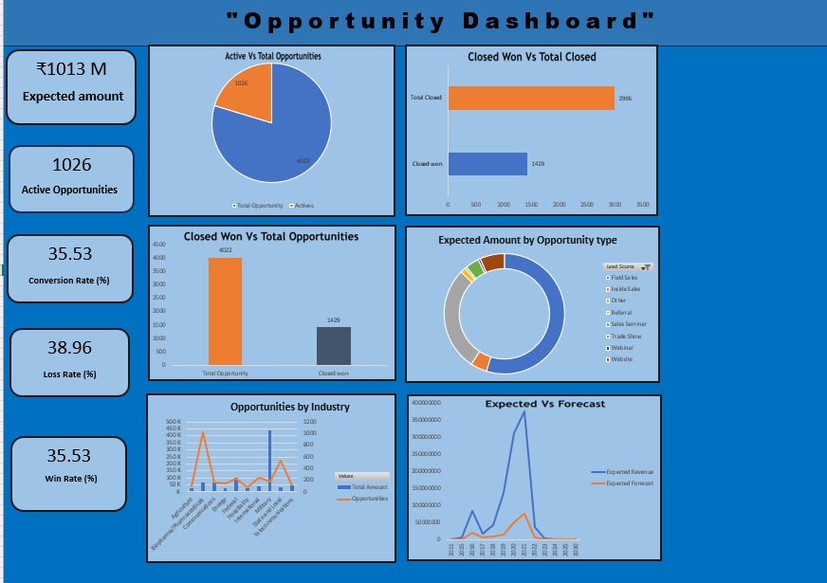
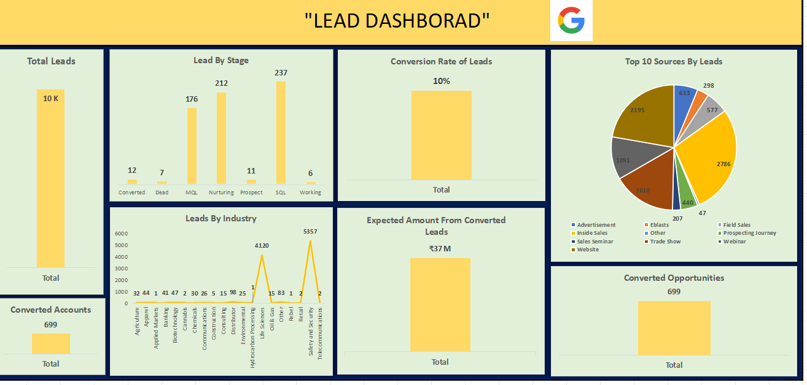

Slide 4
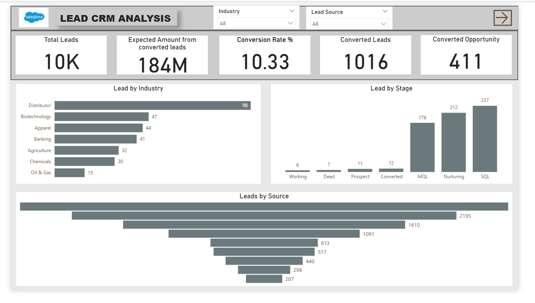
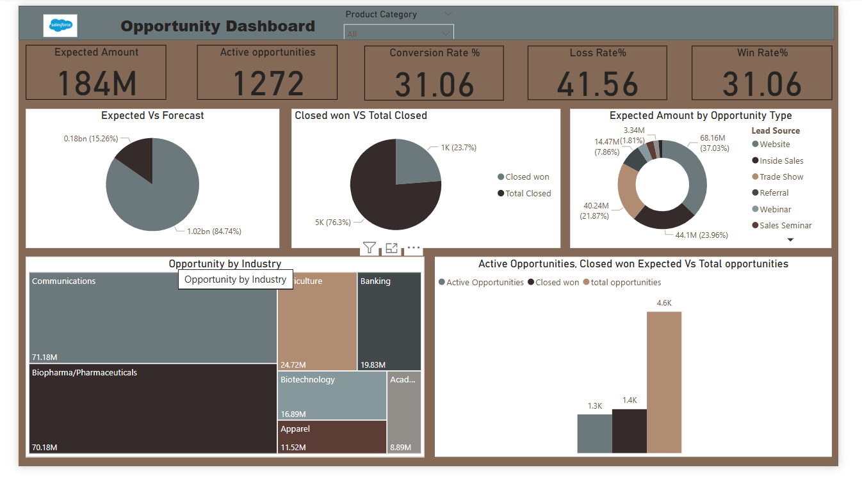

Slide 5
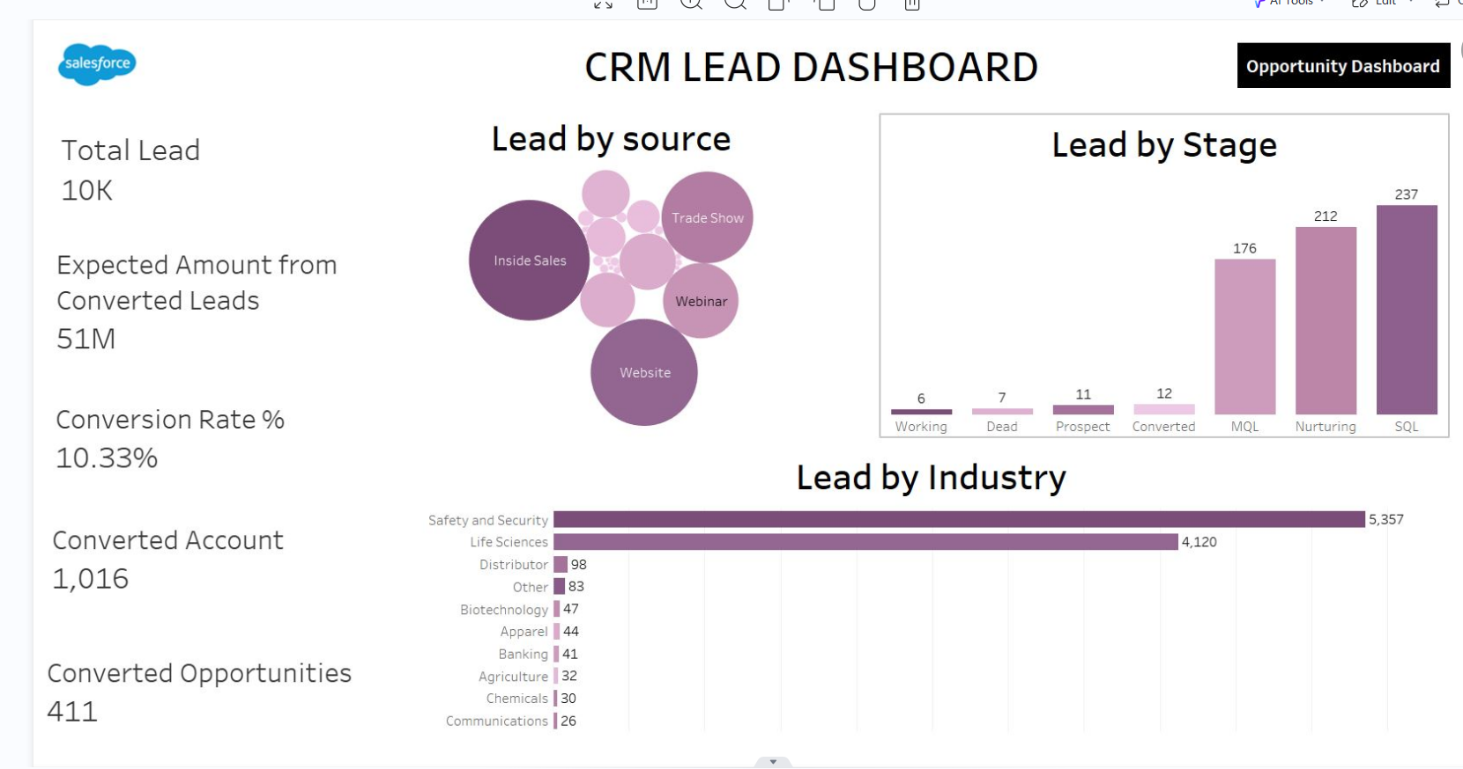
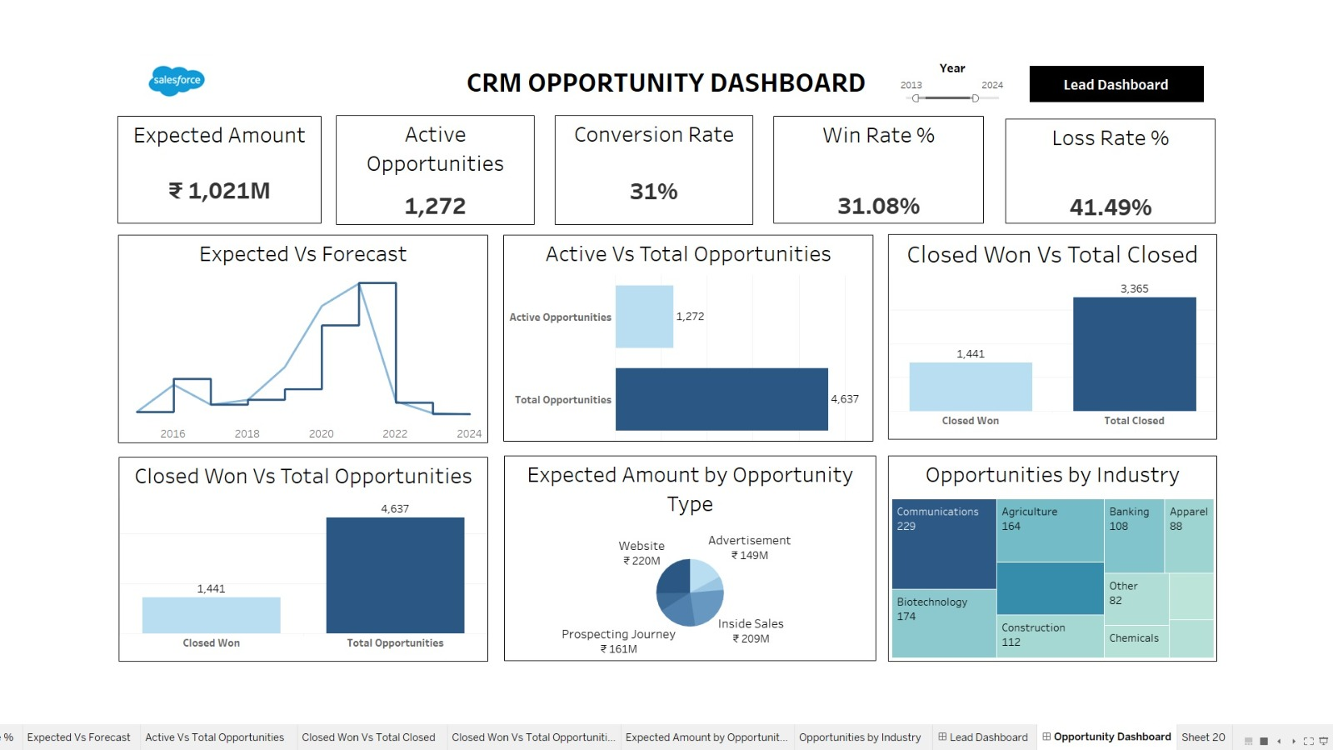

Slide 6
Key Performance Matrix( Lead )
1013 M
Expected Amount
1026
Active opportunities
Conversion Rate
35.53%
38.96%
Loss Rate
35.53%
Win Rate

Slide 7
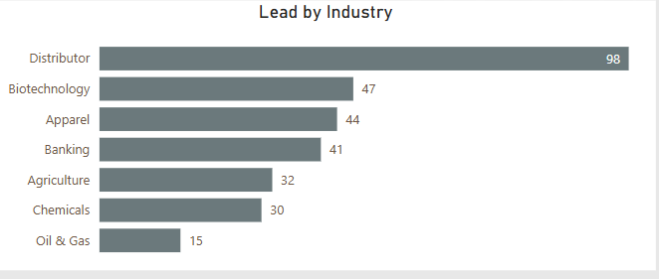
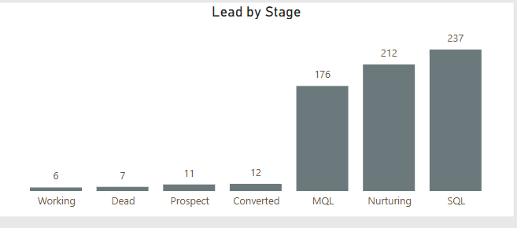
Lead Dashboard
Lead by Industry:
Distributor leads dominate with a count of 98, indicating a key focus area.
Biotechnology and Apparel follow, suggesting moderate engagement in those sectors.
Oil & Gas has the lowest count, possibly an area for exploration or deprioritization.
Lead by Stage:
The highest stage count is for SQL (237) and Nurturing (212), indicating that leads are actively moving through the funnel.
MQL (176) is also significant, but there seems to be a bottleneck in the early stages.
Converted (12) leads seem relatively low compared to total pipeline size, signaling an opportunity to optimize conversion strategies.

Slide 8
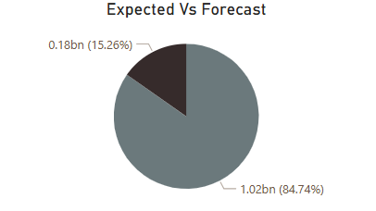
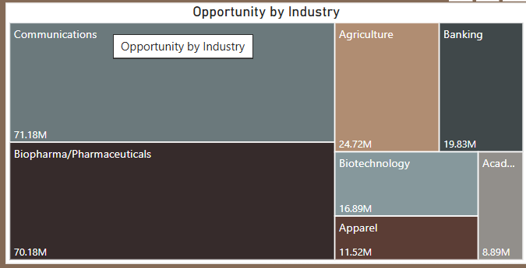
Opportunity Dashboard
Expected Vs Forecast (Pie Chart)
This chart compares the expected vs. forecasted values.
1.02 billion (84.74%) represents the forecasted amount.
0.18 billion (15.26%) represents the expected amount.
The forecast is significantly higher than the expected value, indicating a strong projection.
Opportunity by Industry (Treemap Chart)
This chart breaks down opportunities by industry.
The largest opportunities are in Communications (71.18M) and Biopharma/Pharmaceuticals (70.18M).
Other notable industries:
Agriculture (24.72M)
Banking (19.83M)
Biotechnology (16.89M)
Apparel (11.52M)

Slide 9
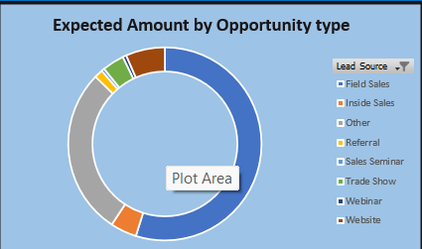
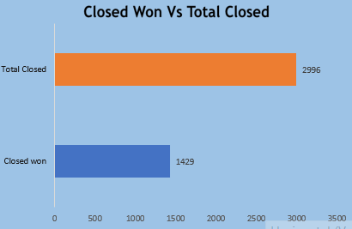
Expected Amount by opportunity type (Donut Chart)
Website Leads Lead – Largest revenue source (37.03%, $68.16M).
Inside Sales & Trade Shows – Key contributors (23.96% & 21.87%).
Smaller Channels – Referrals (7.86%), webinars (1.81%), and sales seminars.
Strategic Focus – Strengthen top sources, improve weaker ones.
Closed Won Vs Total Closed (Bar Chart)
Total Closed Deals – 2,996 deals were closed in total.
Closed Won – 1,429 deals were successfully won.
Win Rate – Approximately 48% of closed deals were won.
Improvement Needed – Focus on increasing the win rate for better conversions.

Slide 10
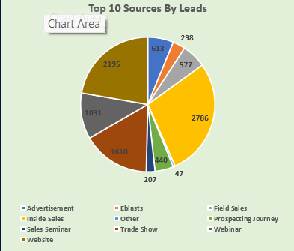
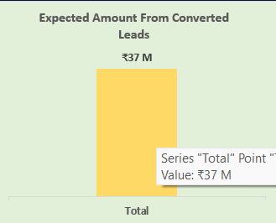
This pie chart represents the Top 10 Sources by Leads, categorizing lead generation channels by their contribution. Key sources include Inside Sales (2,786 leads), Website (2,195 leads), and Sales Seminar (1,610 leads). Other sources like Trade Shows, Webinars, and Advertisements also contribute to lead acquisition. Would you like insights on optimizing lead sources for better conversions
This bar chart represents the Expected Amount from Converted Leads, showing a total value of ₹37 million. It highlights the revenue potential from leads that have successfully converted, providing insight into the effectiveness of lead conversion strategies. Would you like a deeper analysis or comparison with other metrics

Slide 11
A Customer Relationship Management (CRM) system is used in a company to manage interactions with customers, streamline processes, and improve profitability. Here are some key functions of CRM for a company:
1. Lead Management
Tracks and captures leads from multiple sources (website, social media, email, etc.).
Assigns leads to sales representatives for follow-ups.
2. Sales Pipeline Management
Helps sales teams track opportunities from prospecting to closing deals.
Provides insights into sales performance and forecasts.
3. Customer Service & Support
Manages customer inquiries, complaints, and support tickets.
Automates responses and improves customer satisfaction.
4. Marketing Automation
Runs targeted email campaigns, social media marketing, and lead nurturing.
Tracks marketing ROI and customer engagement.
5. Reporting & Analytics
Generates reports on sales performance, customer behavior, and marketing effectiveness.

Slide 12
Thank you

